Slide 1
Mixed ANOVA (GLM 5)
Chapter 14

Slide 2
Mixed ANOVA
Mixed:
1 or more Independent variable uses the same participants (repeated measures)
1 or more Independent variable uses different participants (between subjects)

Slide 3
Mixed ANOVA
Data Screening:
Accuracy, Missing, Outliers (long format)
Assumptions:
Additivity (remember r < .999)
Normality
Linearity
Homogeneity (Levene’s AND Mauchly’s)
Homoscedasticity

Slide 4
An Example: Speed Dating
Does personality and gender interact to predict speed dating rating?
IV 1 (Personality): High Charisma, Some Charisma, Dullard
IV 2 (Gender): Male or Female?
Dependent Variable (DV): rating of the date
100% = The prospective date was perfect!
0% = I’d rather date my own mother

Slide 5
An Example: Speed Dating
Gender = between subjects
Personality = repeated measures
Which means that we will have to melt personality, but leave gender as is in the dataset.

Slide 6
An Example: Speed Dating
Remember:
You have to have a participant number.
You will NOT need to create new variables (like double repeated measures), unless you have a multi-way design with many repeated components.

Slide 7
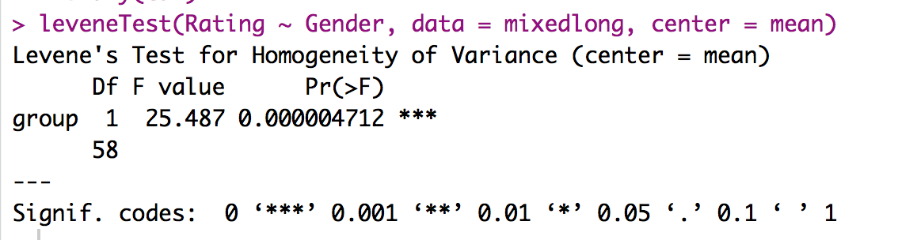
Levene’s Test
Levene’s test would occur after the data screening but before the ANOVA
After you melt!
Only put in your in between subjects IV.

Slide 8
Levene’s Test
In theory, to correct, we should do a robust weighted ANOVA
This procedure is described at the end of Field chapter 14.

Slide 9
Mauchly’s Test
You will get Mauchly’s through the EZ ANOVA output.
You will NOT get information for the between subjects main effect (because it’s not part of that assumption).
But you will get information for the interaction because it includes a repeated measures piece.

Slide 10
Mixed ANOVA
output = ezANOVA(data = mixedlong,
dv = Rating,
wid = partno,
within = Charisma,
between = Gender,
detailed = TRUE,
type = 3)

Slide 11
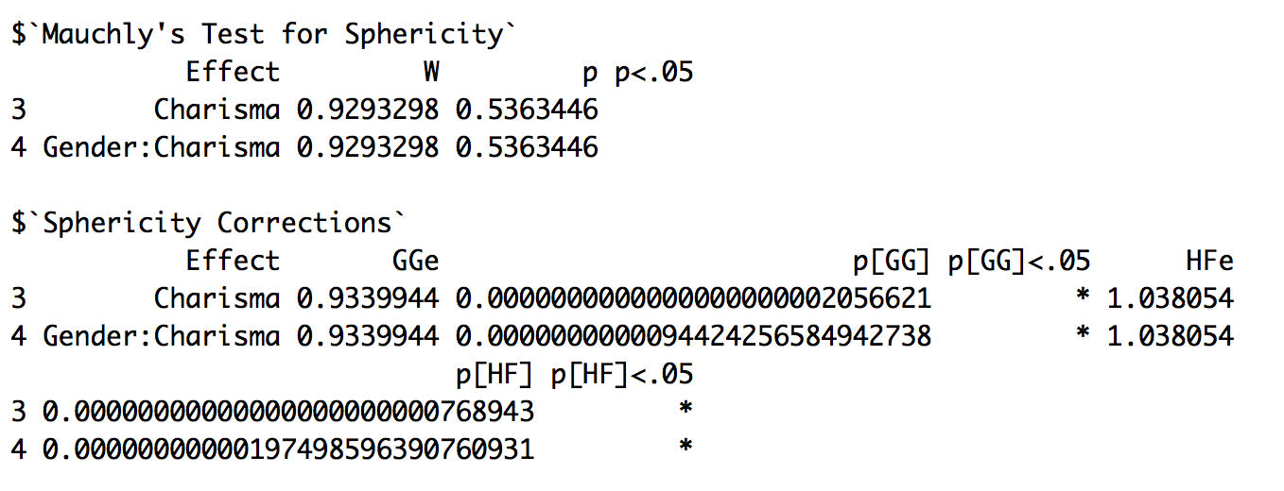
Mauchly’s Test
So we do not need to correct.

Slide 12
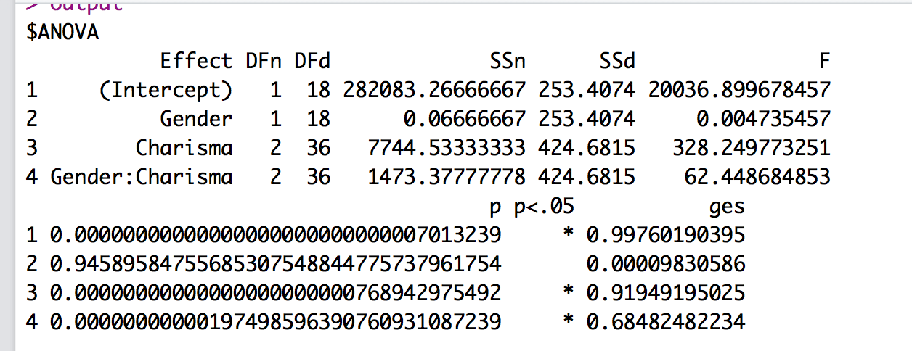
Mixed ANOVA

Slide 13
Mixed ANOVA
Main effect of charisma:
F(2, 36) = 328.25, p <.001, n² = .92
Main effect of gender:
F(1, 18) < .01, p = .95, n² < .01
Interaction of charisma & gender:
F(2, 36) = 62.45, p <.001, n² = .68

Slide 14
Main Effects
If you wanted to analyze the main effects post hocs, what would you do?

Slide 15
Main Effects
Between subjects variables with more than two levels:
Use the agricolae library:
Run the ANOVA with the aov() function, saving the output.
Independent t with a Tukey, Bonferroni, SNK, or Scheffe correction
You can also use the pairwise.t.test (be sure paired = FALSE) with a Bonferroni correction.
You can also use the lme/glht Tukey option.

Slide 16
Main Effects
Repeated measures variables with more than two levels:
Use pairwise.t.test (paired = TRUE) using a Bonferroni correction.
You can also use the lme/glht Tukey option.

Slide 17
Simple Effects
We can apply those same ideas to a simple effects analysis.
As always, with interactions, we first have to split up one of the variables.
Go with the larger one! That creates less post hoc tests to run/write up = more power.

Slide 18
Simple Effects
The tricky part about a simple effects analysis with mixed ANOVAs is making sure that you run the correct post hoc test.
Pick one variable to SPLIT.
Pick one variable to ANALYZE.

Slide 19
Simple Effects
If between subjects is the analysis option:
Run aov, Agricolae library options
Run pairwise.t.test with paired = FALSE, Bonferroni
Run LME test, then glht test for Tukey

Slide 20
Simple Effects
If repeated measures is the analysis option:
Run pairwise.t.test with paired = TRUE, Bonferroni
Run LME test, then glht test for Tukey

Slide 21
Simple Effects
Here’s why lme (even though it is more work) is a good option → you don’t have to think quite as hard to remember which code/test to use.
Plus! Once you get the hang of regression, you could completely ditch ANOVA altogether.

Slide 22
Simple Effects
 | High | Average | Low
Male |  |  |  | Repeated Measures
Female |  |  |  | Repeated Measures
 | Between Subjects | Between Subjects | Between Subjects
Since gender has a smaller number of levels, we can see if gender affects ratings for each type of charisma
That’s going to be independent t because we are comparing the between subjects levels.

Slide 23
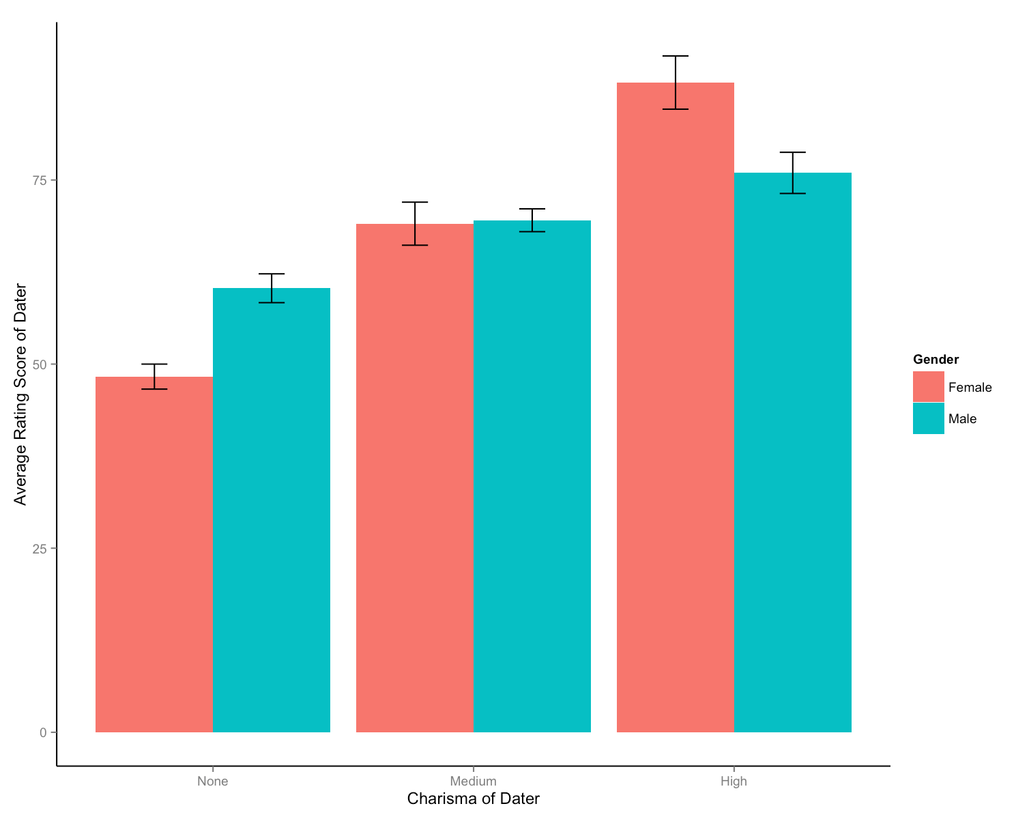

Slide 24
Simple Effects
Let’s look at the options for simple effects with between subjects analysis, since the repeated measures ones you can find in C13.

Slide 25
Simple Effects
 | Tukey Agricolae | Bonferroni t.test | Tukey LME/GLHT
None, Men V Women | < .001 | < .001 | < .001
Medium Men V Women | .75 | .75 | .74
High Men V Women | < .001 | < .001 | < .001
So pick a favorite.

Slide 26
Write ups
Need to include
Type of ANOVA (2X3 mixed factorial)
Main effect F values (2)
Interaction F values (1)
Type of post hoc test and correction
Post hoc values (p, d)
Figure

